Slide 1
Project 1 -
An Analysis in Diabetes Predictors
Michigan State University
2023
Natalie Ericson
Alex Stewart
Dawson Michael Marcade
Cortney Cantwell

Slide 2
AGENDA
01
02
03
04
OVERVIEW
Description of the project, our driving questions, and hypotheses
THE DATA
The original dataset and what we did with it
ANALYSIS
What the findings look like and what they mean
CONCLUSION
What the findings mean moving forward

Slide 3
SECTION
01.
Project Overview
CORTNEY

Slide 4
Goal Statement
We set out to analyze data in search of potential predictors or indicators of Diabetes.
There are many factors commonly known to be associated with having Diabetes, such as a genetic predisposition to developing Type 1 Diabetes, or lifestyle choices contributing to the development of Type 2 Diabetes.
According to the Diabetes Research Institute, 37.3 million people in the United States alone have Diabetes. Another ~8.5 million have it and go undiagnosed.
We have taken a deeper dive into features such as BMI, blood pressure, activity level, and smoking status to evaluate if there are one or more factors that are statistically correlated to the presence of diabetes.
CORTNEY

Slide 5
Our Driving Questions
What are potential predictors of developing diabetes?
If there are multiple predictors, is there one that is the most reliable? If so, which one?
CORTNEY

Slide 6
The Hypotheses
Null Hypothesis
Alternative Hypothesis
Of the following health factors: blood pressure, BMI, smoking habits, and activity levels; BMI is not the the most likely indicator for risk of diabetes.
Of the following health factors: blood pressure, BMI, smoking habits, and activity levels; BMI is the the most likely indicator for risk of diabetes.
CORTNEY

Slide 7
SECTION
02.
The Data
ALEX

Slide 8
Where?
- sourced from Kaggle
- cleaned by the creator
How?
- from the Behavioral Risk Factor Surveillance System (BRFSS) phone survey
What?
- normal distribution vs. skewed
- utilized the binary data format
ALEX
Notes:
BRFSS is conducted by the CDC every year. They collect over 400,000 responses on questions about health related risk behaviors, chronic health conditions, etc
It has been conducted every year since 1984
This data is form 2015 and the original dataset contained responses from 441,455 individuals

Slide 9
Analysis Lifecycle
Manipulated data creating a smaller dataframe
Analyzed each indicator alongside diabetes status
Created BMI bins
Analyzed each indicator within BMI status
Placed each indicator in appropriate BMI bin
Correlation analysis + plotting
ALEX

Slide 10
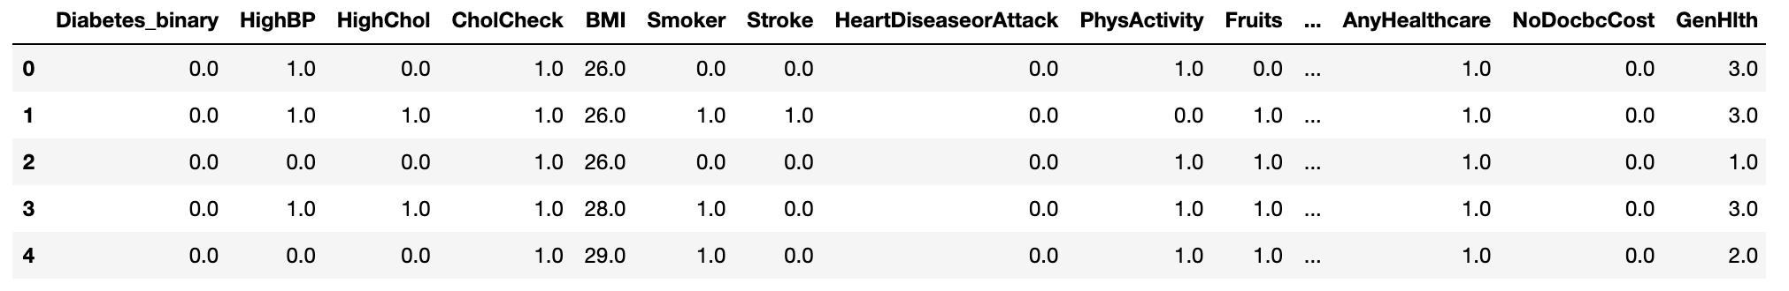
df.head( )
ALEX

Slide 11
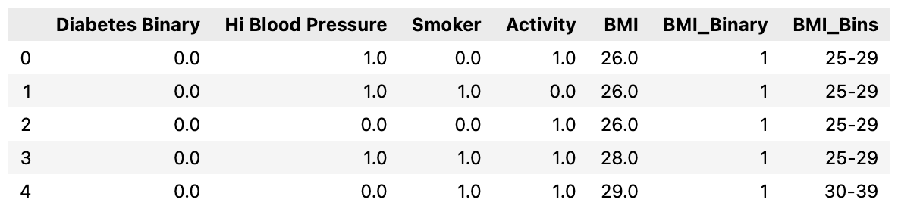
narrowed_df.head( )
ALEX

Slide 12
BMI Bins
Underweight
<19
Healthy Weight
19-25
Overweight
25-29
Obese
30-39
Severely Obese
>40

Slide 13
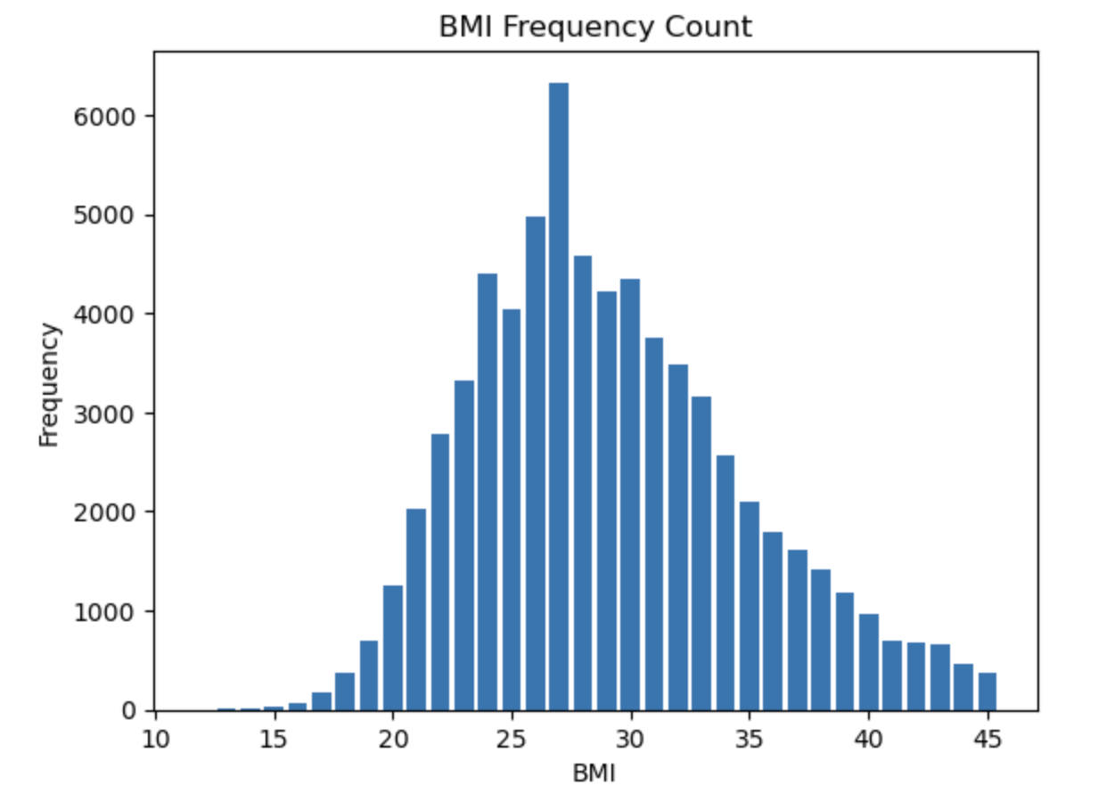
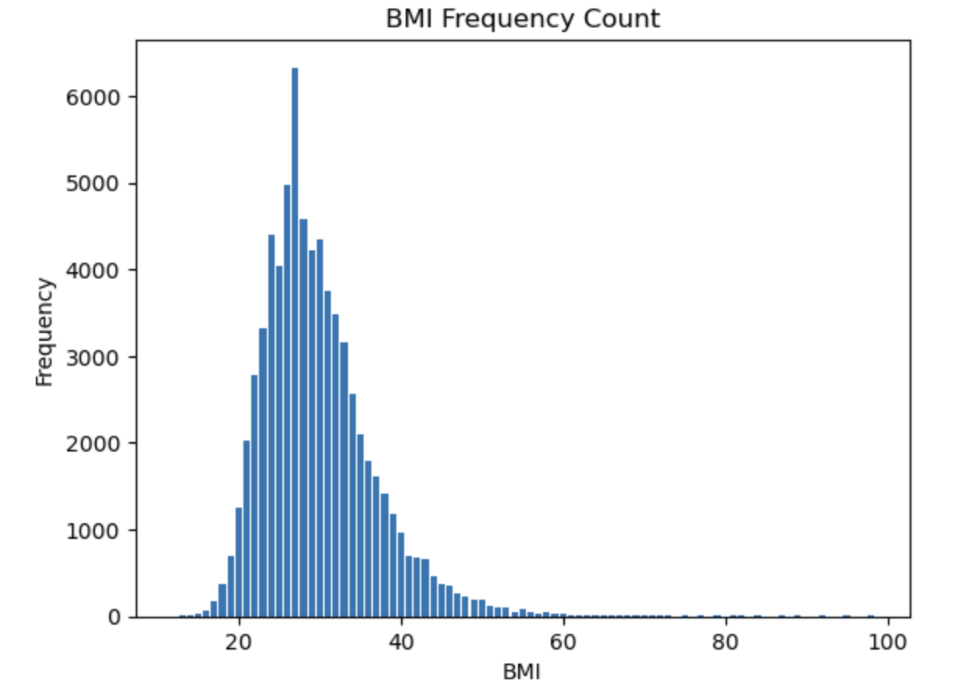
The Dataset
Normal Distribution
Right Skew
ALEX

Slide 14

appending data into each BMI bin
NATALIE

Slide 15
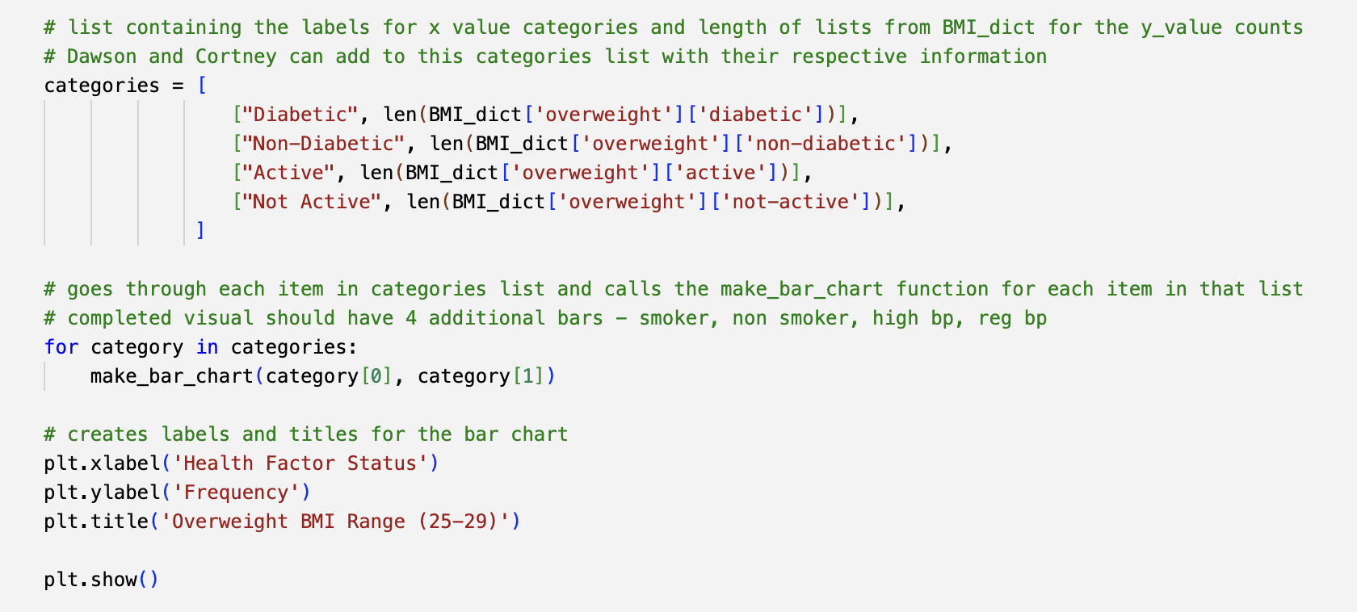
creating bar charts
NATALIE

Slide 16
SECTION
03.
Data Analysis
NATALIE

Slide 17
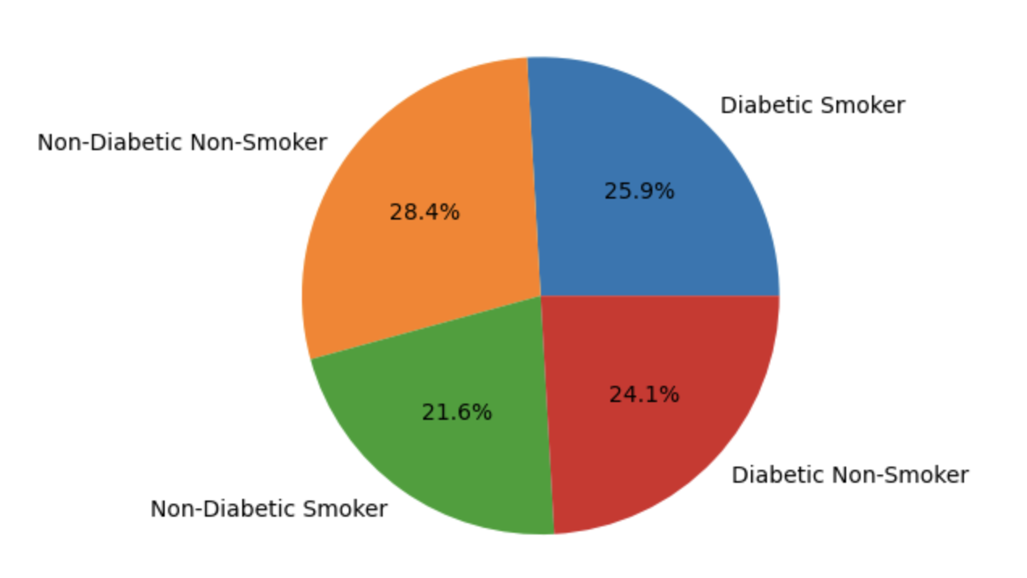
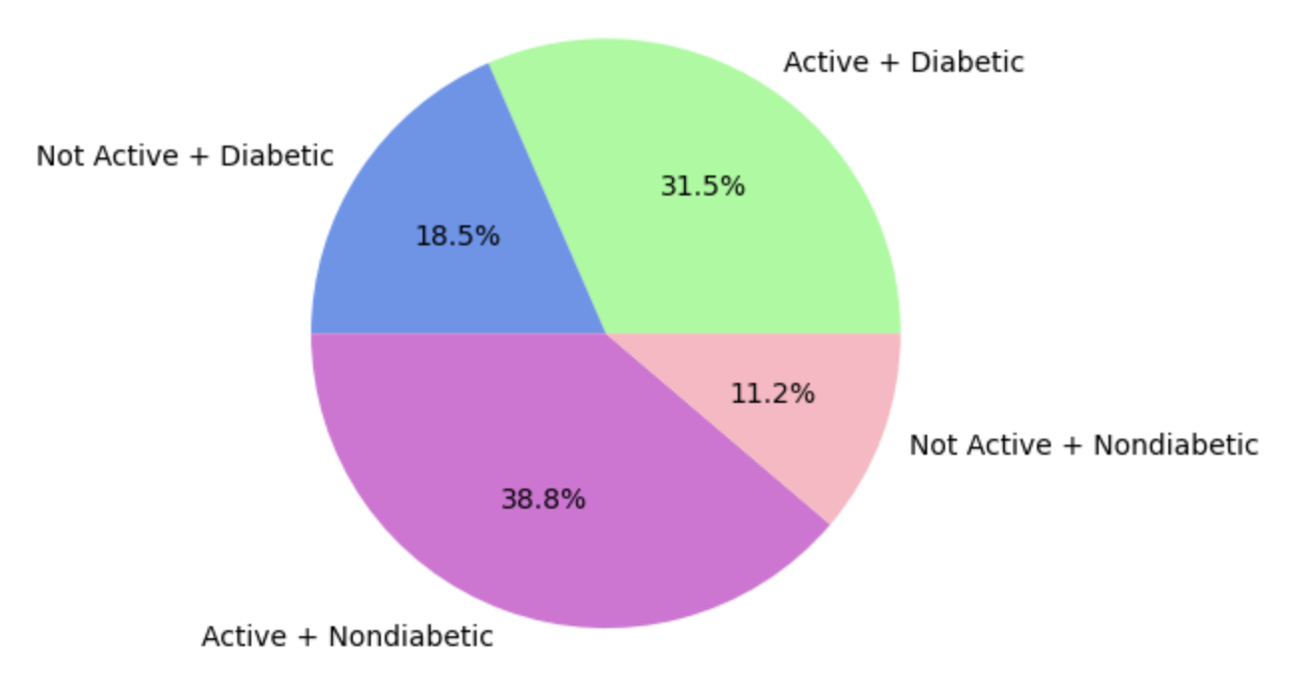
Activity Level
Smoker Status
NATALIE

Slide 18
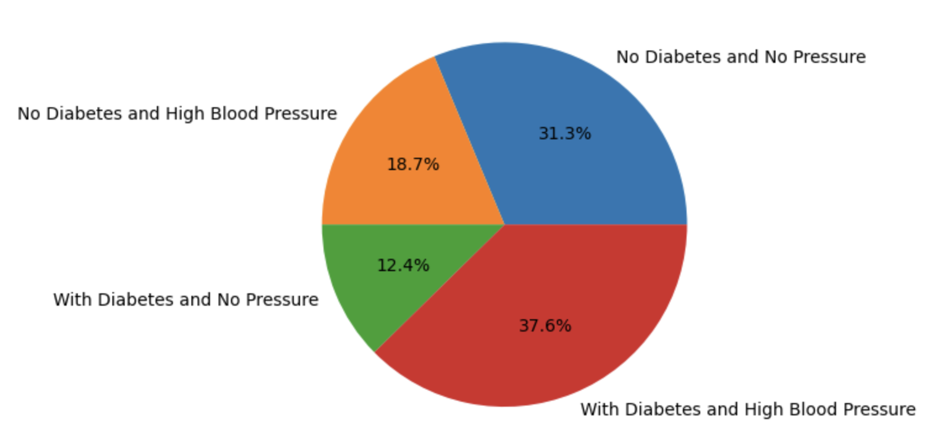
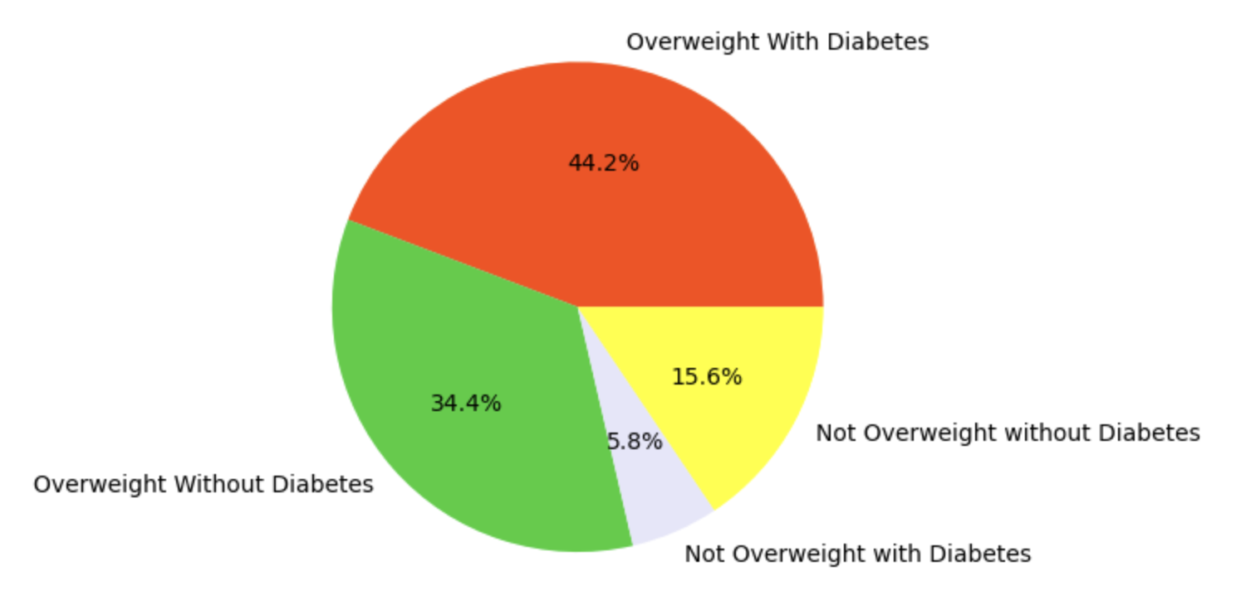
BMI
Blood Pressure
NATALIE

Slide 19
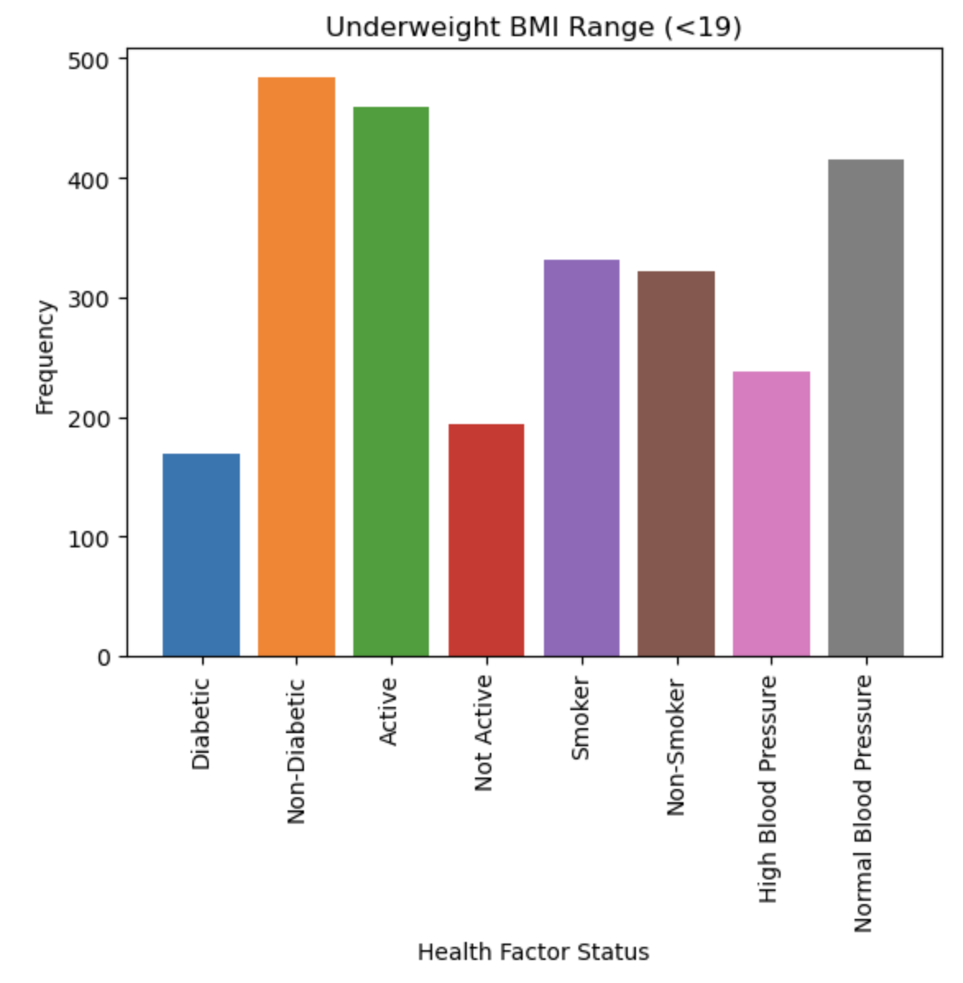
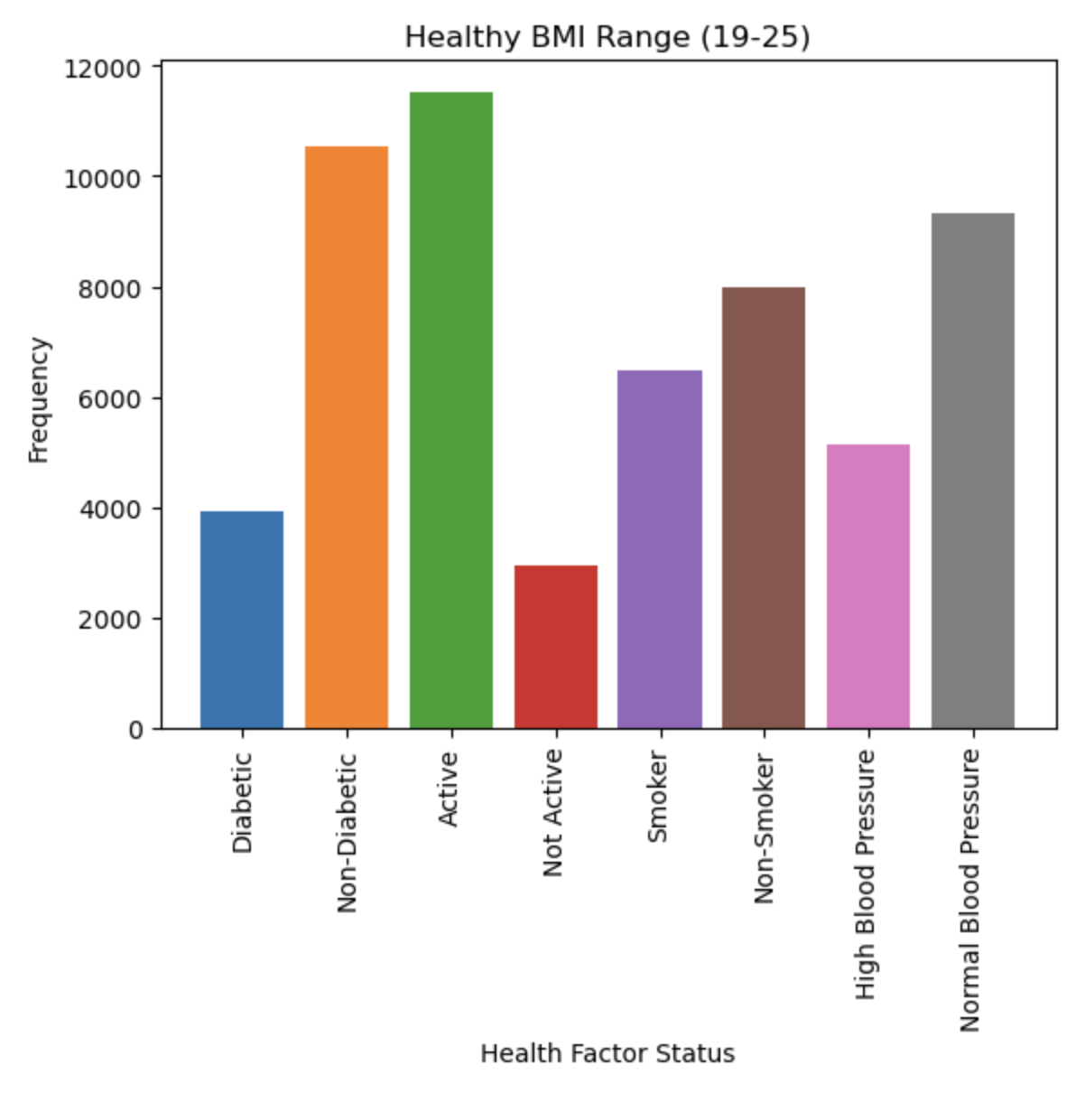
NATALIE

Slide 20
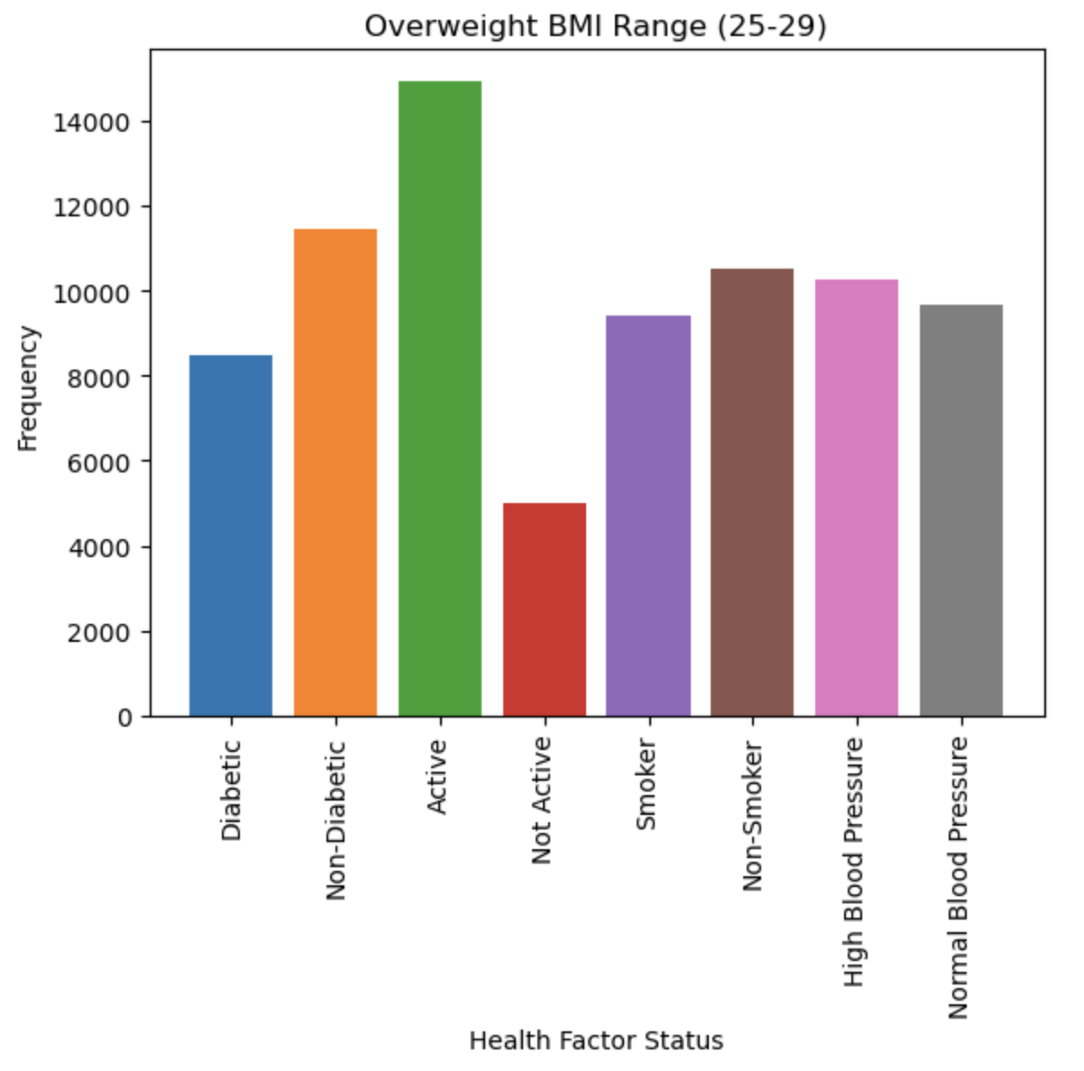
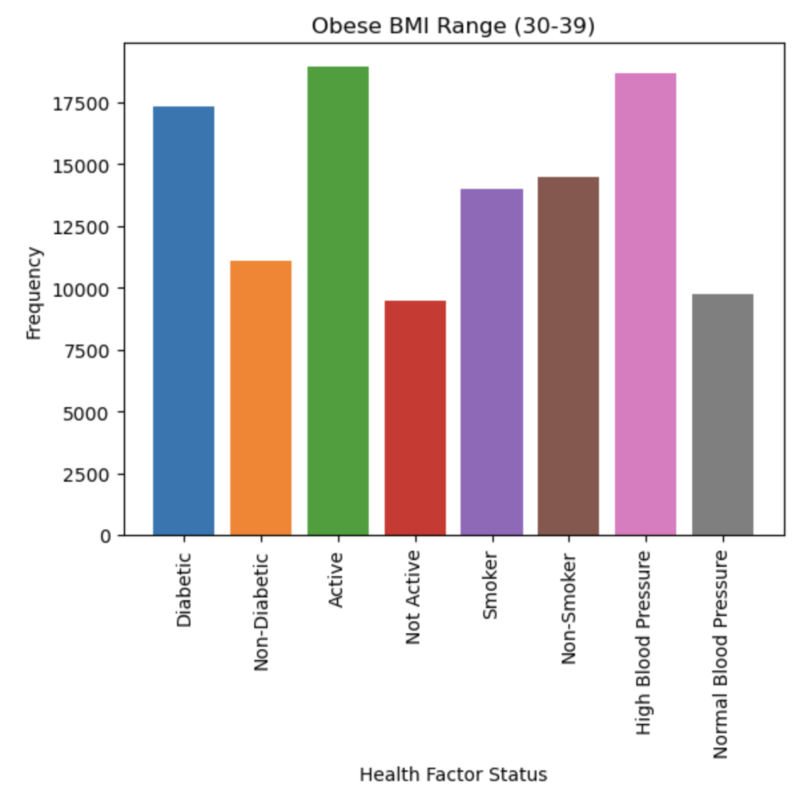
NATALIE

Slide 21
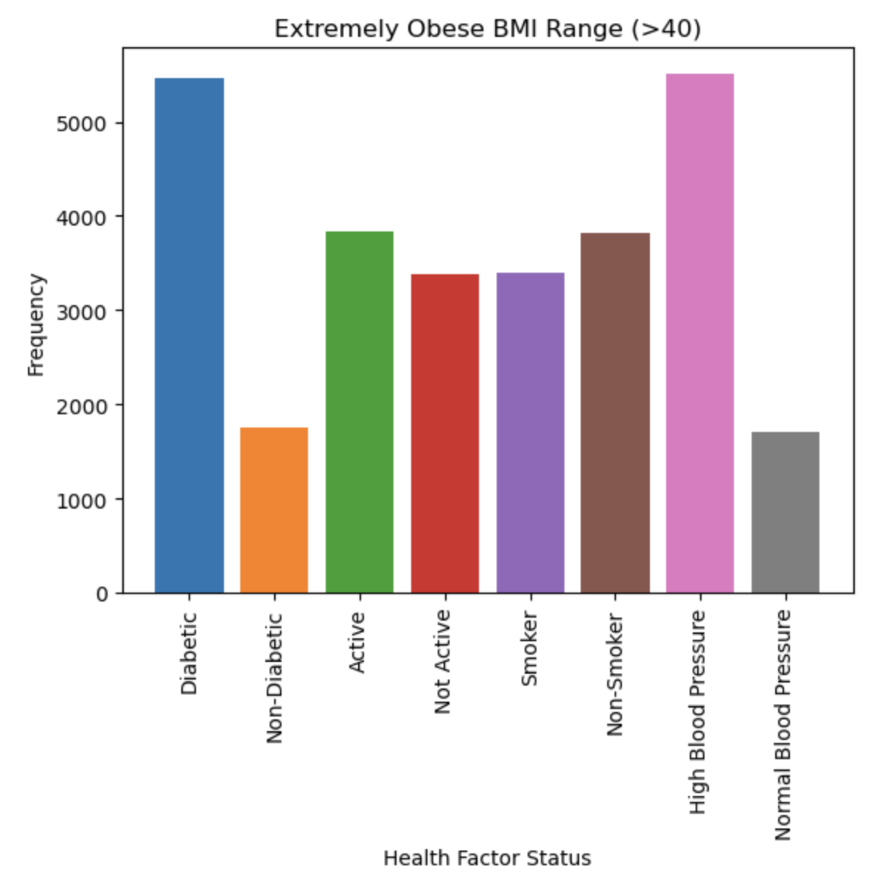
NATALIE

Slide 22
The Numbers
Correlation
Failure to Reject
Of the following health factors: blood pressure, BMI, smoking habits, and activity levels; BMI is not the the most likely indicator for risk of diabetes
Of the following health factors: blood pressure, BMI, smoking habits, and activity levels; BMI is the the most likely indicator for risk of diabetes.
DAWSON

Slide 23
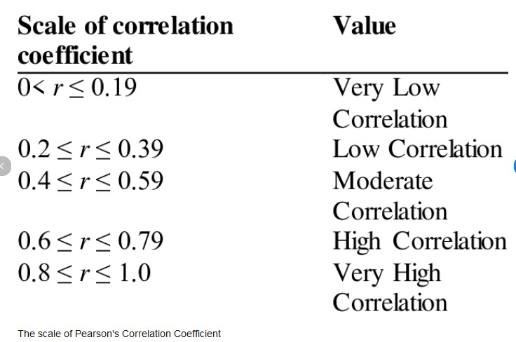
A Correlation Analysis

Slide 24
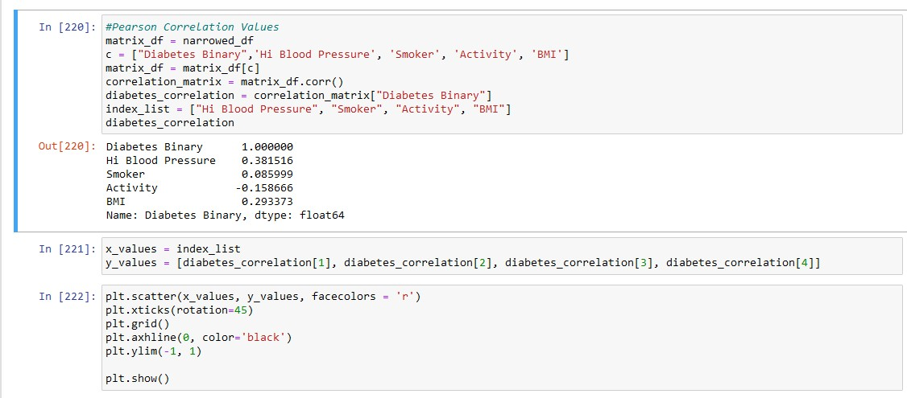
Pearson Correlation Analysis Code

Slide 25
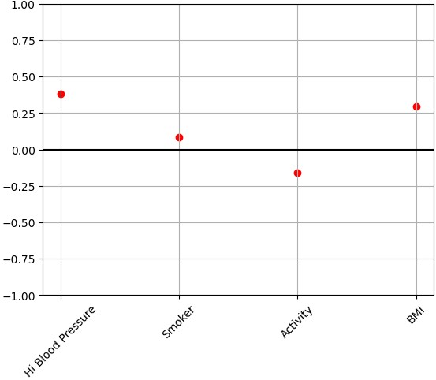
Health Factor Correlation
Correlation graph shows blood pressure correlation at 0.382 while BMI correlation is at 0.293, making blood pressure a more likely contributor to diabetes
DAWSON

Slide 26
SECTION
04.
Conclusion
CORTNEY

Slide 27
Conclusion
Out of all the variables, High Blood Pressure had the highest correlation to Diabetes
We reject our alternative hypothesis which was: BMI would be the best factor for predicting Diabetes
Long-term effects of undiagnosed Diabetes:
Heart attacks and strokes
Nerve damage
Eye problems
Amputation
How we can use this info for the future:
According to the American Heart Association, 122 million Americans that are 20 years old or older have been diagnosed with high blood pressure.
8.5 million americans go undiagnosed with diabetes
Early detection and treatment:
Improve blood sugar control
Delay or prevent Type 2 Diabetes
Better quality of life

Slide 28
THANKS!
Please keep this slide for attribution.

